Slide 1
Agenda for the Day
C# Overview
Datatypes
Conditional & Iterative statements
Conversions
Arrays

Slide 2
About C#
Two languages that are central to .NET framework are C# and Visual Basic.
It is fundamentally a simple and object oriented language.
It was developed by Microsoft development team.
Lot of syntax for C# is obtained C language. C# also shares many similarity with popular Java language, thereby making learning of C# even more simpler.
Several version of C# have come up starting from 2002. The latest version is C# 10.0. Visual Studio 2022 supports this.

Slide 3
Comments
Single line comment
//
// This is a single line comment
Multiline comments
/* */
/* This is a multi
line comment */

Slide 4
Variables
Variables are storage locations that are associated with a value.
The value that a variable stores are of certain data type.
Syntax: Datatype var_name;
There are different types of variables that can be defined in C# depending on the scope : static variables, instance variables, array elements, and local variables.
The variables created inside Method are local. They are available only inside the method where they are declared.
The local variable must always be initialized before using.

Slide 5
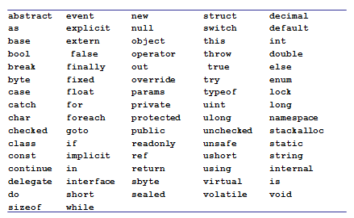
Keywords

Slide 6
C# Datatypes
C# like C and C++ is a strongly typed language and so every variable must have a data type.
Data types in C# are of 2 types
Value types
Reference types.

Slide 7
C# Datatypes
Value types
Built in Data types like int, char, float ,double and user defined types like struct or enum
For every value type there is a type(Class or Struct) in BCL
They are allocated in stack
Value types can not contain the value null.

Slide 8
C# Datatypes
Reference
User defined type created using class or interfaces
Reference types are allocated in heap at runtime.
Reference types can contain the value null

Slide 9
C# Datatypes
Built in Types
Boolean type
bool
Integer types
byte int long sbyte short uint ulong ushort
Character type
char
Floating point types
decimal double float
User Defined Types
enum
struct

Slide 10
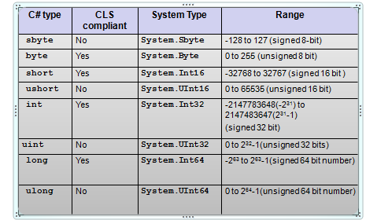
Integer Types

Slide 11
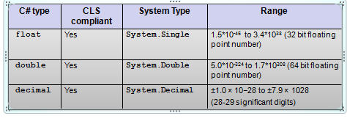
Floating Points

Slide 12
Floating-point literals
Floating-point literals can be written in two ways
Fixed notation: 3.14
Scientific notation: 0.314E1, 314e-2
Floating-point literal types
Literal with no suffix→ is double
Literal with F or f as suffix (Example 3.14f, 3.14F)→ is float
Literal with D or d as suffix (Example 3.14D, 3.14D) → is double
Literal with M or m as suffix (Example 3.14m, 3.14M) → is decimal
decimal d = 3.45; //error
decimal d = 3.45m; //ok
float f = 3.4;// error
float f = 3.4f;// ok

Slide 13
Character type and Character Literal
char keyword is alias for System.Char
It is CLS compliant.
char c=‘a’; //ok
char c=1; //error

Slide 14
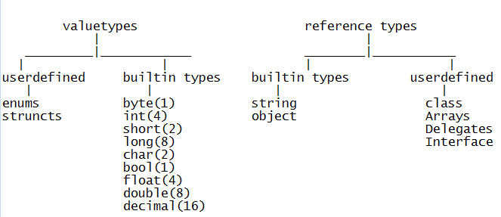

Slide 15
Identifiers Naming Rules
Identifiers are variables, methods , class or any other named constructs in C#
Rules
Should not be a keyword
Must start with a letter or underscore or @
Subsequent characters can be a letter, number or underscore

Slide 16
Operators

Slide 17
Operators-Arithmetic
+ | - | / | * | ++ | -- | %
Most of the operators work the same way as it does in C.
Applicable to integer and floating point types
int i = 10;
int j = i+ 255;
byte k = i + 255; //error
const double PI = 3.14;
double f = PI + 12;
When 2 of any integral types (other than long) are involved in arithmetic operation, the result is an int.
byte i = 10;
byte j = 20;
j=j+i; //error

Slide 18
Operators-Relational
== | != | < | > | >= | <=
Relational operator return bool value – true or false.
int i=10;
int j=20;
Console.WriteLine( i>j ); // output is False
Console.WriteLine(i == 10); // output is True

Slide 19
Operators-Logical
&& | || | !
These are both boolean operators. These work only on bool values.
&& checks if the first condition is false. If it is so then it doesn't evaluate the second condition.
|| checks if the first condition is true. If it is so then it doesn't evaluate the second condition.
int i=0;
int j=2;
bool b= (i>j) && (j++>i);
Console.WriteLine(j);
What does the code print?

Slide 20
Assignment Operators
= | += | -= | *= | /= | %=
int a = 10;
int b=2;
a+=b; // 12 same as a=a+b;
Console.WriteLine(a);
double d=45.3;
d/=1.2;
Console.WriteLine(d); // 37.75 same as d=d/1.2
float d1=2.4f;
d1 %= 1.2f;
Console.WriteLine(d1); // 0

Slide 21
Other Operators
Operator | Name | Example
?: | Ternary operator | 10 % 2 > 0 ? 1 : 10
[] | Array subscript | a[1]
() | Cast
. | dot operator | n.Length
is | Type Conversion
as
typeof | In refection
new
checked
unchecked
=> | Lambda

Slide 22
Conversion

Slide 23
Conversions
Type conversion is a process of converting values from one data type to another data types
Conversion types:
Implicit Conversion
Casting
Boxing
Un Boxing

Slide 24
C# Implicit Conversions
Implicit numerical conversions
byte → short, int, long, float, double, decimal
char →int, long, float, double, decimal
short →int, long, float, double, decimal
int →long, float, double, decimal
long →float, double, decimal
float → double

Slide 25

Example
using System;
class Convert{
public static void Main(){
char c='A';
int i=c;
Console.WriteLine(i);
long l=23456789100;
float f=l;
Console.WriteLine(f);
}}
vice versa is not allowed implicitly

Slide 26
Casting
Any conversion that happens in the opposite direction of implicit numerical conversions requires explicit request from the compiler through casting.
Casting
Number casting example
long l2 = 12500;
int i2 = (int)l2;
int i = 256;
byte b1 = (byte)i;

Slide 27
Casting
floating point cast to int example
float f=12.f;
int i2 = (int)f;
Example 1:
float b1 = 1f; int b2 = 2;
float b3 = b1 + b2;
Example 2:
long b1 = 1; double b2 = 2;
double b3 = b1 + b2;
Example 3:
double b2 = 2;
int a3 = (int)b2;

Slide 28
Convert
Note that conversions of numeric value to string and vice versa, bool to string and vice versa etc. is not possible either implicitly or explicitly.
This can be done through the methods below:
Example:
/* Boolean values */
ii= Convert.ToBoolean("true");
Console.WriteLine(ii); //True
ii = Convert.ToBoolean("gg");
Console.WriteLine(ii); // Runtime error call //FormatException

Slide 29
Convert
/* String values */
string s= Convert.ToString(true);
Console.WriteLine(s); //True
s = Convert.ToString(1.23);
Console.WriteLine(s); //1.23
s = Convert.ToString('A');
Console.WriteLine(s); //A
Console.WriteLine(Convert.ToString(null));
// prints nothing
/* Numeric Values */
int i = Convert.ToInt32("1009");
short j = Convert.ToInt16("100");
long k = Convert.ToInt64("9292929");
byte b=Convert.ToByte("20");
No ToFloat method!
double d=Convert.ToDouble("sss"); // runtime error

Slide 30
Parse() Method
Another way to convert strings to basic type is by using System Type
Every System Type has Parse() method that can be used to convert a string into the respective System Type.
<Type>. Parse(string s)
Where <Type> could be any System Type/ C# type that we looked at earlier.
using System;
class ParseTest{
static void Main(string[] args) {
sbyte i1= sbyte.Parse("123");
float f1= float.Parse("123.3");
decimal d1= decimal.Parse("123.45");
bool b= bool.Parse("true");
Console.WriteLine("{0}, {1}, {2}, {3}, {4}, {5}, {6}", i1, f1, d1, b);
}}

Slide 31
Boxing And UnBoxing
Boxing and unboxing allows a value-type to be converted to and from type object.
Converting a value type to reference type is called Boxing. Boxing is implicit conversion.
int i = 1;
object o = (object)i; // boxing
Or simply object o=i;
And reverse is unboxing
o = 1;
i = (int)o; // unboxing
Unboxing is explicit conversion.
When value-type are boxed they are stored in heap.
Boxing and unboxing are computationally expensive processes.

Slide 32
Conditional Statement & Loops

Slide 33
If statement
if statement
if(Condition)
{
statements;
}
Condition must evaluate to bool value

Slide 34
If else statement
Condition must evaluate to bool value
if/else statement
if(Condition)
{ statements; }
[
else{
statements;
}
]
Example: if (c > 0) c++; else c--;

Slide 35
Switch statement
switch statement
switch(var)
{
case val1:
statements;
break;
case val2:
statements;
break;
……
default: statements;
break; }
Any numeric value or string
constants

Slide 36
Example
char c;
c = char.Parse(Console.ReadLine());
switch(c){
case 'r': Console.WriteLine("RED");
break;
case 'g': Console.WriteLine("GREEN");
break;
case 'b': Console.WriteLine("BLUE");
break;}
}
C# compiler enforces that every case statement must have a break statement. In other words control cannot fall through from one case label to another.

Slide 37
Multiple cases
char c;
c = char.Parse(Console.ReadLine());
switch(c){
case 'r':
case 'R':Console.WriteLine("RED");
break;
case 'g':
case 'G': Console.WriteLine("GREEN");
break;
case 'b':
case 'B': Console.WriteLine("BLUE");
break;}
}

Slide 38
For loop
There are two forms of for statement
for loop
for(intialization; condition;increment/decrement){
//statements
}
Ex: for(int i=0;i<10;i++)
foreach loop:
foreach(object variable in itemlist){
//statements
}
Ex: int[] arr={1,2,3,4,5};
foreach(int s in arr)
Console.WriteLine(s);

Slide 39
While and Do while
// while loop
while(Condition) {
statements
}
Ex: int i=0;
while(i<10) {
Console.WriteLine(i);
i++; }
do-while loop
do{
statements
}while(Condition);
Ex: int i=0;
do {
Console.WriteLine(i);
i++;
} while(i<10);
Condition must evaluate to bool value

Slide 40
Break and continue
Used with loop statements
break is used to break out of the loop. Is used with switch statement also.
continue is used to exit out of current iteration and continue with the next iteration.
int j = 100;
while (true)
{
if (j % 13 == 0) break;
else
j++;
}
Console.WriteLine(j); //104

Slide 41
Arrays
Array is a collection of similar type of data.
Array stores multiple values of same type.
Arrays are reference types.
They are automatically of a predefined type System.Array
Syntax:
Datatype [] Array_name=new Data type[size];
Data type- specifies what type of data storing into the array. Array type can be value type or reference type.
Array_name-Indicates name of the array
new-It allocates memory to the array at runtime
Size-Indicates how many elements storing into the array
ex: int []a=new int[5];
string []names=new string[3];

Slide 42
Arrays
Assigning values to array
1.Int []a=new int[4]
a[0]=10
a[1]=20
a[2]=30 0 1 2 3
a[3]=40
2. Int []a=new int[4]{10,20,30,40}
3.Int []a={10,20,30,40} //Dynamic allocation
Accessing elements
a[0];
In arrays index starts from 0
If there is a mismatch between the declared size and the number of initializes , a compile time error is generated.
10 | 20 | 30 | 40

Slide 43
Arrays
members of System. Array
sort() -It sorts array elements in ascending order
System.Array.Sort(array name)
reverse()-It arrange array elements in reverse order
System.Array.Reverse(array name)
copy() –It copies one Array elements into to another array
System.Array.Copy(source array name, destination array name, count)
Length- It returns size of the array
Rank-It returns dimension of the array

Slide 44
Multidimensional Arrays
A multidimensional array stores values in multiple rows and columns.
An array can have a maximum of 32 dimensions.
Two types of multidimensional array
Rectangular array
Jagged array

Slide 45
Rectangle Array
A multidimensional array where length of each row is fixed through out the array.
Syntax: Data type[,] array_name=
new Data type[row_size, col_size]
Creation:
int[,] matrix = new int[5,5];
Accessing array elements:
matrix[0,1]=9;
Initializing
int[,] matrix = new int[,] { {0, 1}, {2, 3}, {4, 5} };

Slide 46
Jagged Arrays
A jagged array is an array of arrays.
The element with in the jagged array it self is an array.
The arrays may be of different sizes.
Definition requires specification of size for only the topmost array.
Datytype [ ][ ] Array_name = new Datatpe[size][ ] ;
Size indicates no of arrays storing into jagged array
Creation:
int[][] myarr=new int[3][];
Creating arrays in the jagged array,
myarr[1]= new int[3]{0,1,2};
Accessing elements
myarr[0][1]=8;
Accessing the length of row 0→ myarr[0].Length
Initializing
int[][] myarr= new int[][] { new int[] {0,1}, new int[] {3,4,5} };
Or simply int[][] myarr = { new int[] { 0, 1 }, new int[] { 3, 4, 5 } };

Slide 47
Overall Summary
C# Overview
Datatypes
Conditional & Iterative statements
Conversions
Arrays

Slide 48
THANK YOU

